Slide 1


Artificial Intelligence For CBSE Teachers
Workshop Under
AICTE Training and Learning Program (ATAL) Initiative
Organized by:
The LNMIIT Centre for Smart Technologies
7th to 11th June 2021

Slide 2
Part – B Evaluation Class X

Slide 3
Evaluation methods(Class X)
What is evaluation
Confusion matrix
Evaluation methods
Accuracy, Precision, Recall, and F score

Slide 4
Introduction to Evaluation

Slide 5
Evaluation
Evaluation is the process of understanding the reliability of any AI model, based on outputs by feeding test dataset into the model and comparing with actual answers.
There can be different Evaluation techniques, depending of the type and purpose of the model.

Slide 6
Evaluation terminologies
Confusion matrix
Accuracy
Precision
Recall
F Score

Slide 7
Confusion matrix
The result of comparison between the prediction and reality can be recorded in what we call the confusion matrix.
The confusion matrix allows us to understand the prediction results.
Note that it is not an evaluation metric but a record which can help in evaluation.

Slide 8
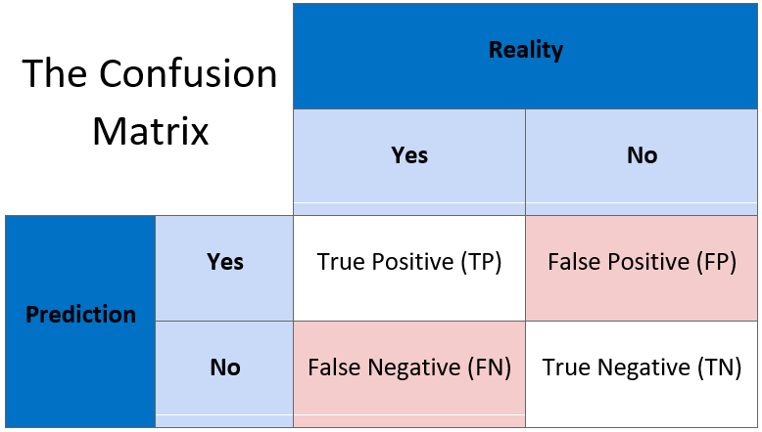

Slide 9
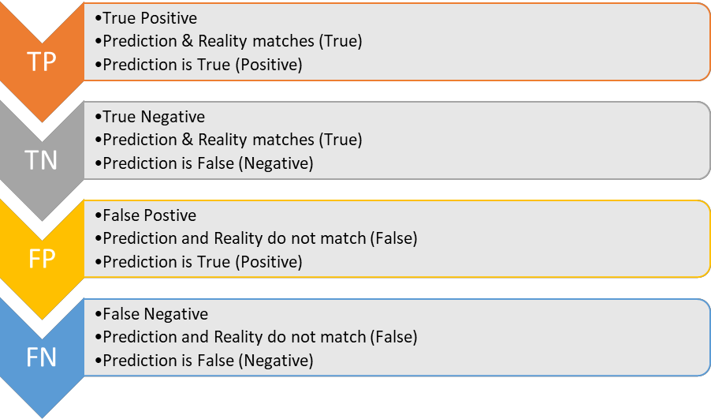

Slide 10
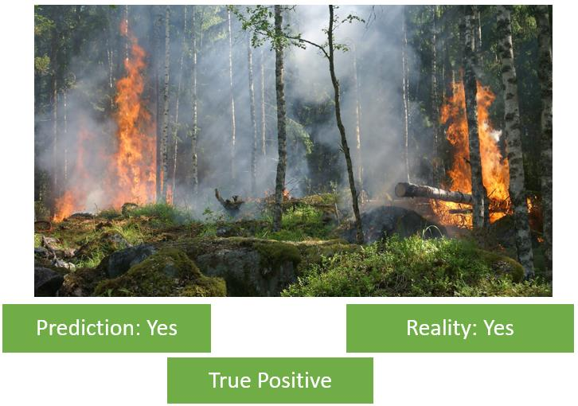
True Positive

Slide 11
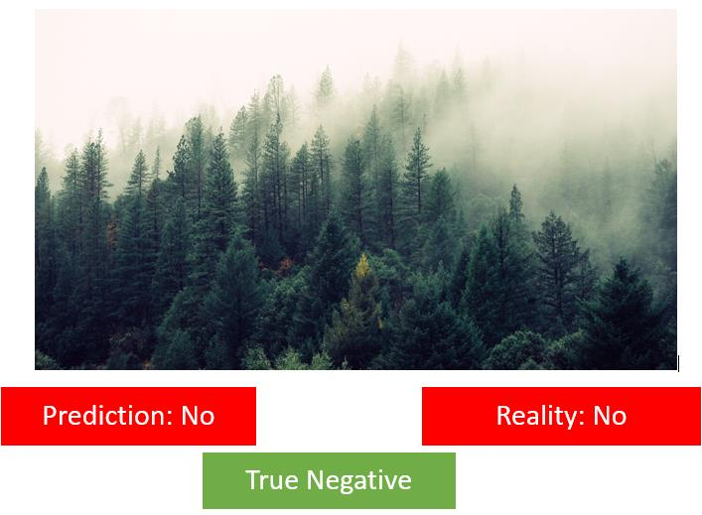
True Negative

Slide 12
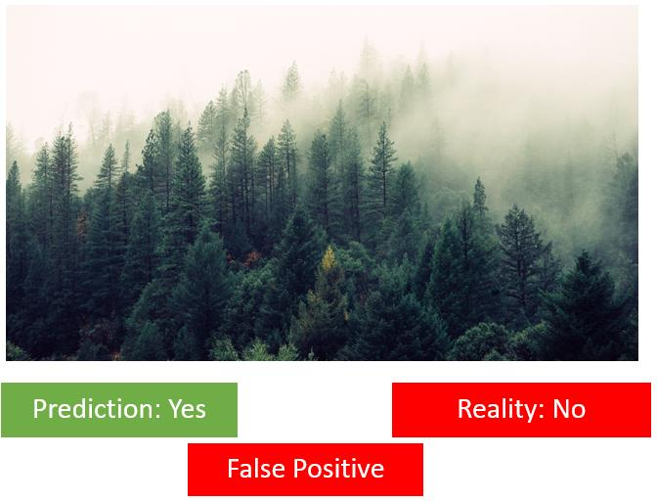
False Positive

Slide 13
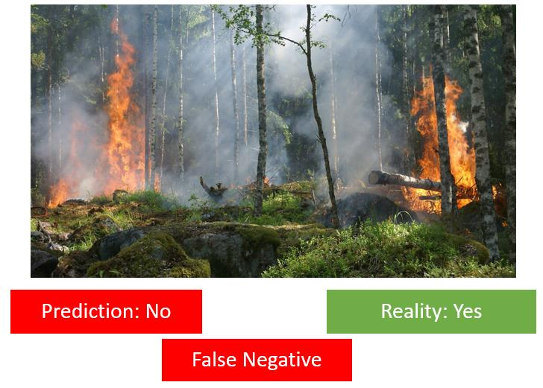
False Negative

Slide 14
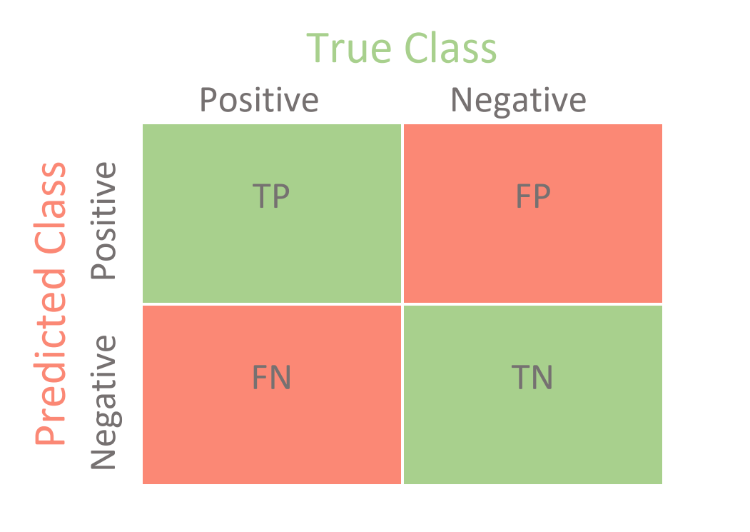
Summary of Confusion matrix

Slide 15
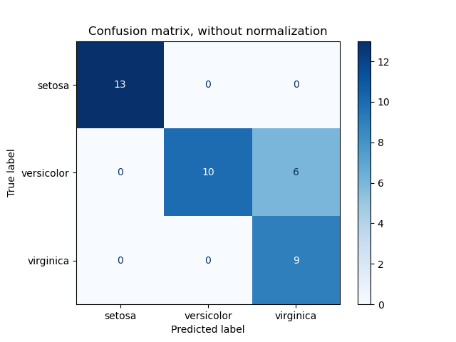
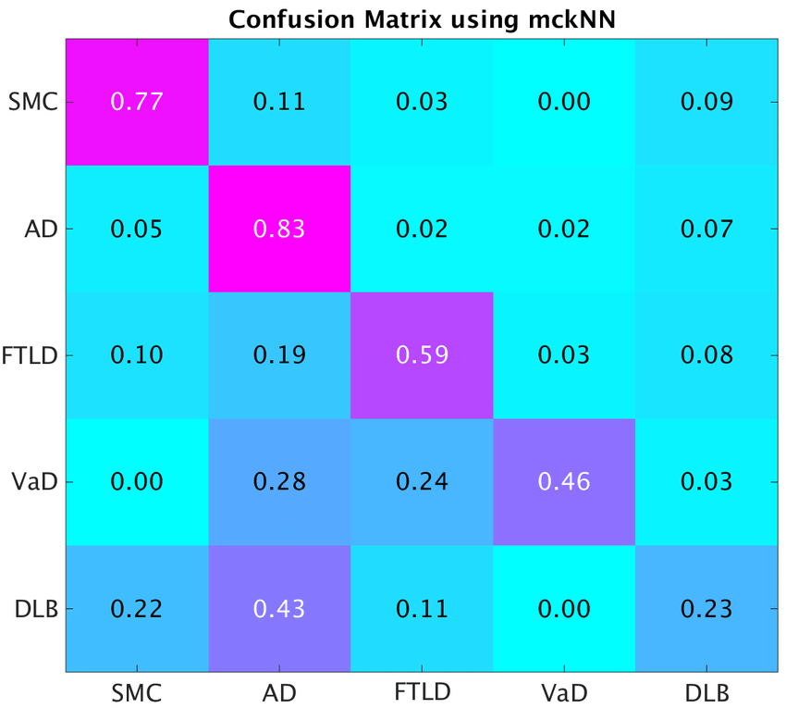
Multi-class Confusion matrix

Slide 16
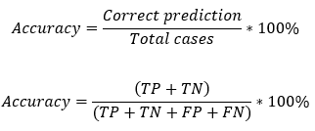
Accuracy
Accuracy is defined as the percentage of correct predictions out of all the observations.
A prediction can be said to be correct if it matches the reality.
Here, we have two conditions in which the Prediction matches with the Reality: True Positive and True Negative.

Slide 17
Limitation
Consider the following data:
True Positives = 0
True Negatives = 98
Total cases = 100
Now: Accuracy = 98/100 = 98%
It is very high but useless, because we should focus more on the True Positives as well.

Slide 18
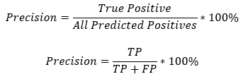
Precision
Precision is defined as the percentage of true positive cases versus all the cases where the prediction is true.
That is, it takes into account the True Positives and False Positives.

Slide 19
Limitation
Going back to the Forest Fire example, in this case, assume that the model always predicts that there is a forest fire irrespective of the reality.
In this case, all the Positive conditions would be taken into account that is, True Positive (Prediction = Yes and Reality = Yes) and False Positive (Prediction = Yes and Reality = No).
So this is also not completely reliable.

Slide 20
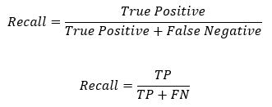
Recall
It can be defined as the fraction of positive cases that are correctly identified.
It majorly takes into account the true reality cases where in Reality there was a fire but the machine either detected it correctly or it didn’t.

Slide 21
Now as we notice, we can see that the Numerator in both Precision and Recall is the same: True Positives.
But in the denominator, Precision counts the False Positives while Recall takes False Negatives into consideration.

Slide 22
Which is better? (Precision or Recall)
Choosing between Precision and Recall depends on the condition in which the model has been deployed.
In a case like Forest Fire, a False Negative can cost us a lot and is risky too.
Another case where a False Negative can be dangerous is Viral Outbreak.
On the other hand, there can be cases in which the False Positive condition costs us more than False Negatives.
One such case is Mining. Imagine a model telling you that there exists treasure at a point and you keep on digging there but it turns out that it is a false alarm.

Slide 23
Similarly, let’s consider a model that predicts that a mail is spam or not.
If the model always predicts that the mail is spam, people would not look at it and eventually might lose important information.
Here also False Positive condition (Predicting the mail as spam while the mail is not spam) would have a high cost.

Slide 24
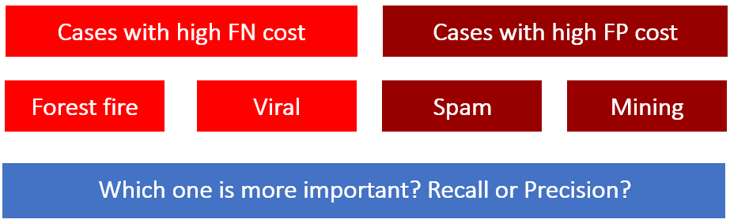

Slide 25

F1 score
F1 score can be defined as the measure of balance between precision and recall.
An ideal situation would be when we have a value of 1 (that is 100%) for both Precision and Recall.
In that case, the F1 score would also be an ideal 1 (100%). It is known as the perfect value for F1 Score.
As the values of both Precision and Recall ranges from 0 to 1, the F1 score also ranges from 0 to 1.

Slide 26
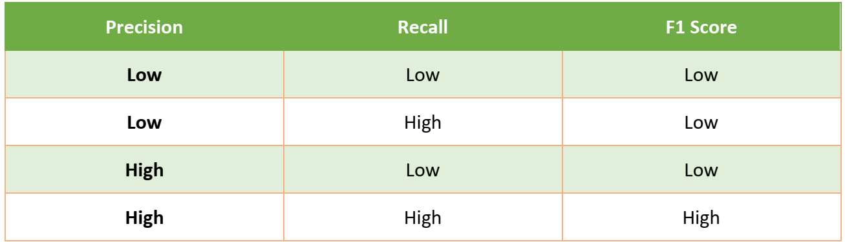
Balanced method

Slide 27
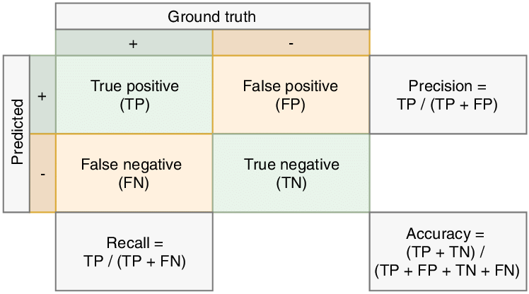
Summary

Slide 28
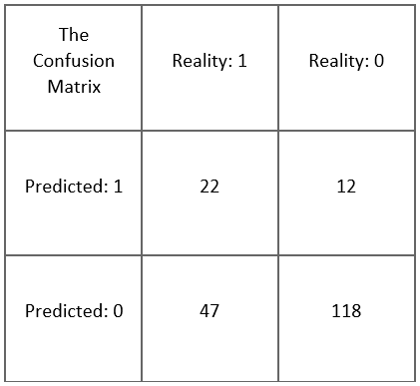
Practice
Accuracy = (22+118)/(22+12+47+118) = 0.703
Precision = 22/(22+12) = .647
Recall = 22/(22+47) = .318
F1 Score = (2*.647*.318)/(0.647+.318) = 0.426

Slide 29
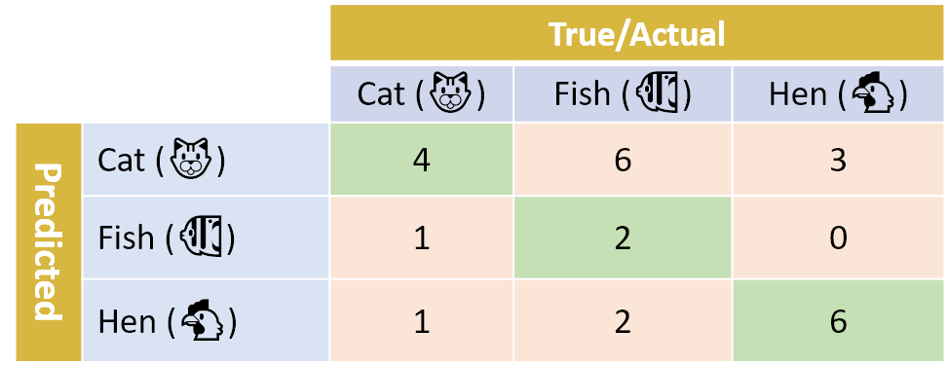
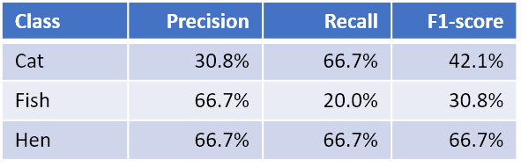
Multiclass calculations
We extend the same logic to calculate the Precision and Recall of each class individually.
Then we calculate the F1 score individually.

Slide 30
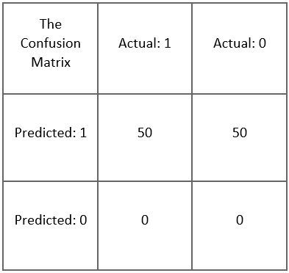
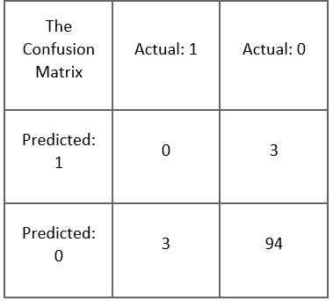
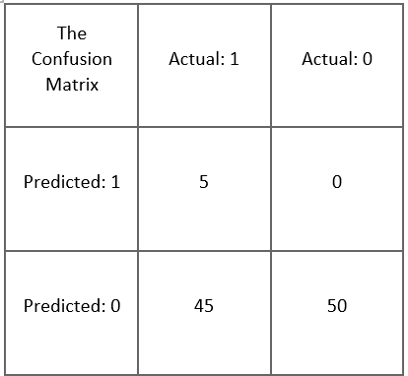
More examples.

